Slide 1
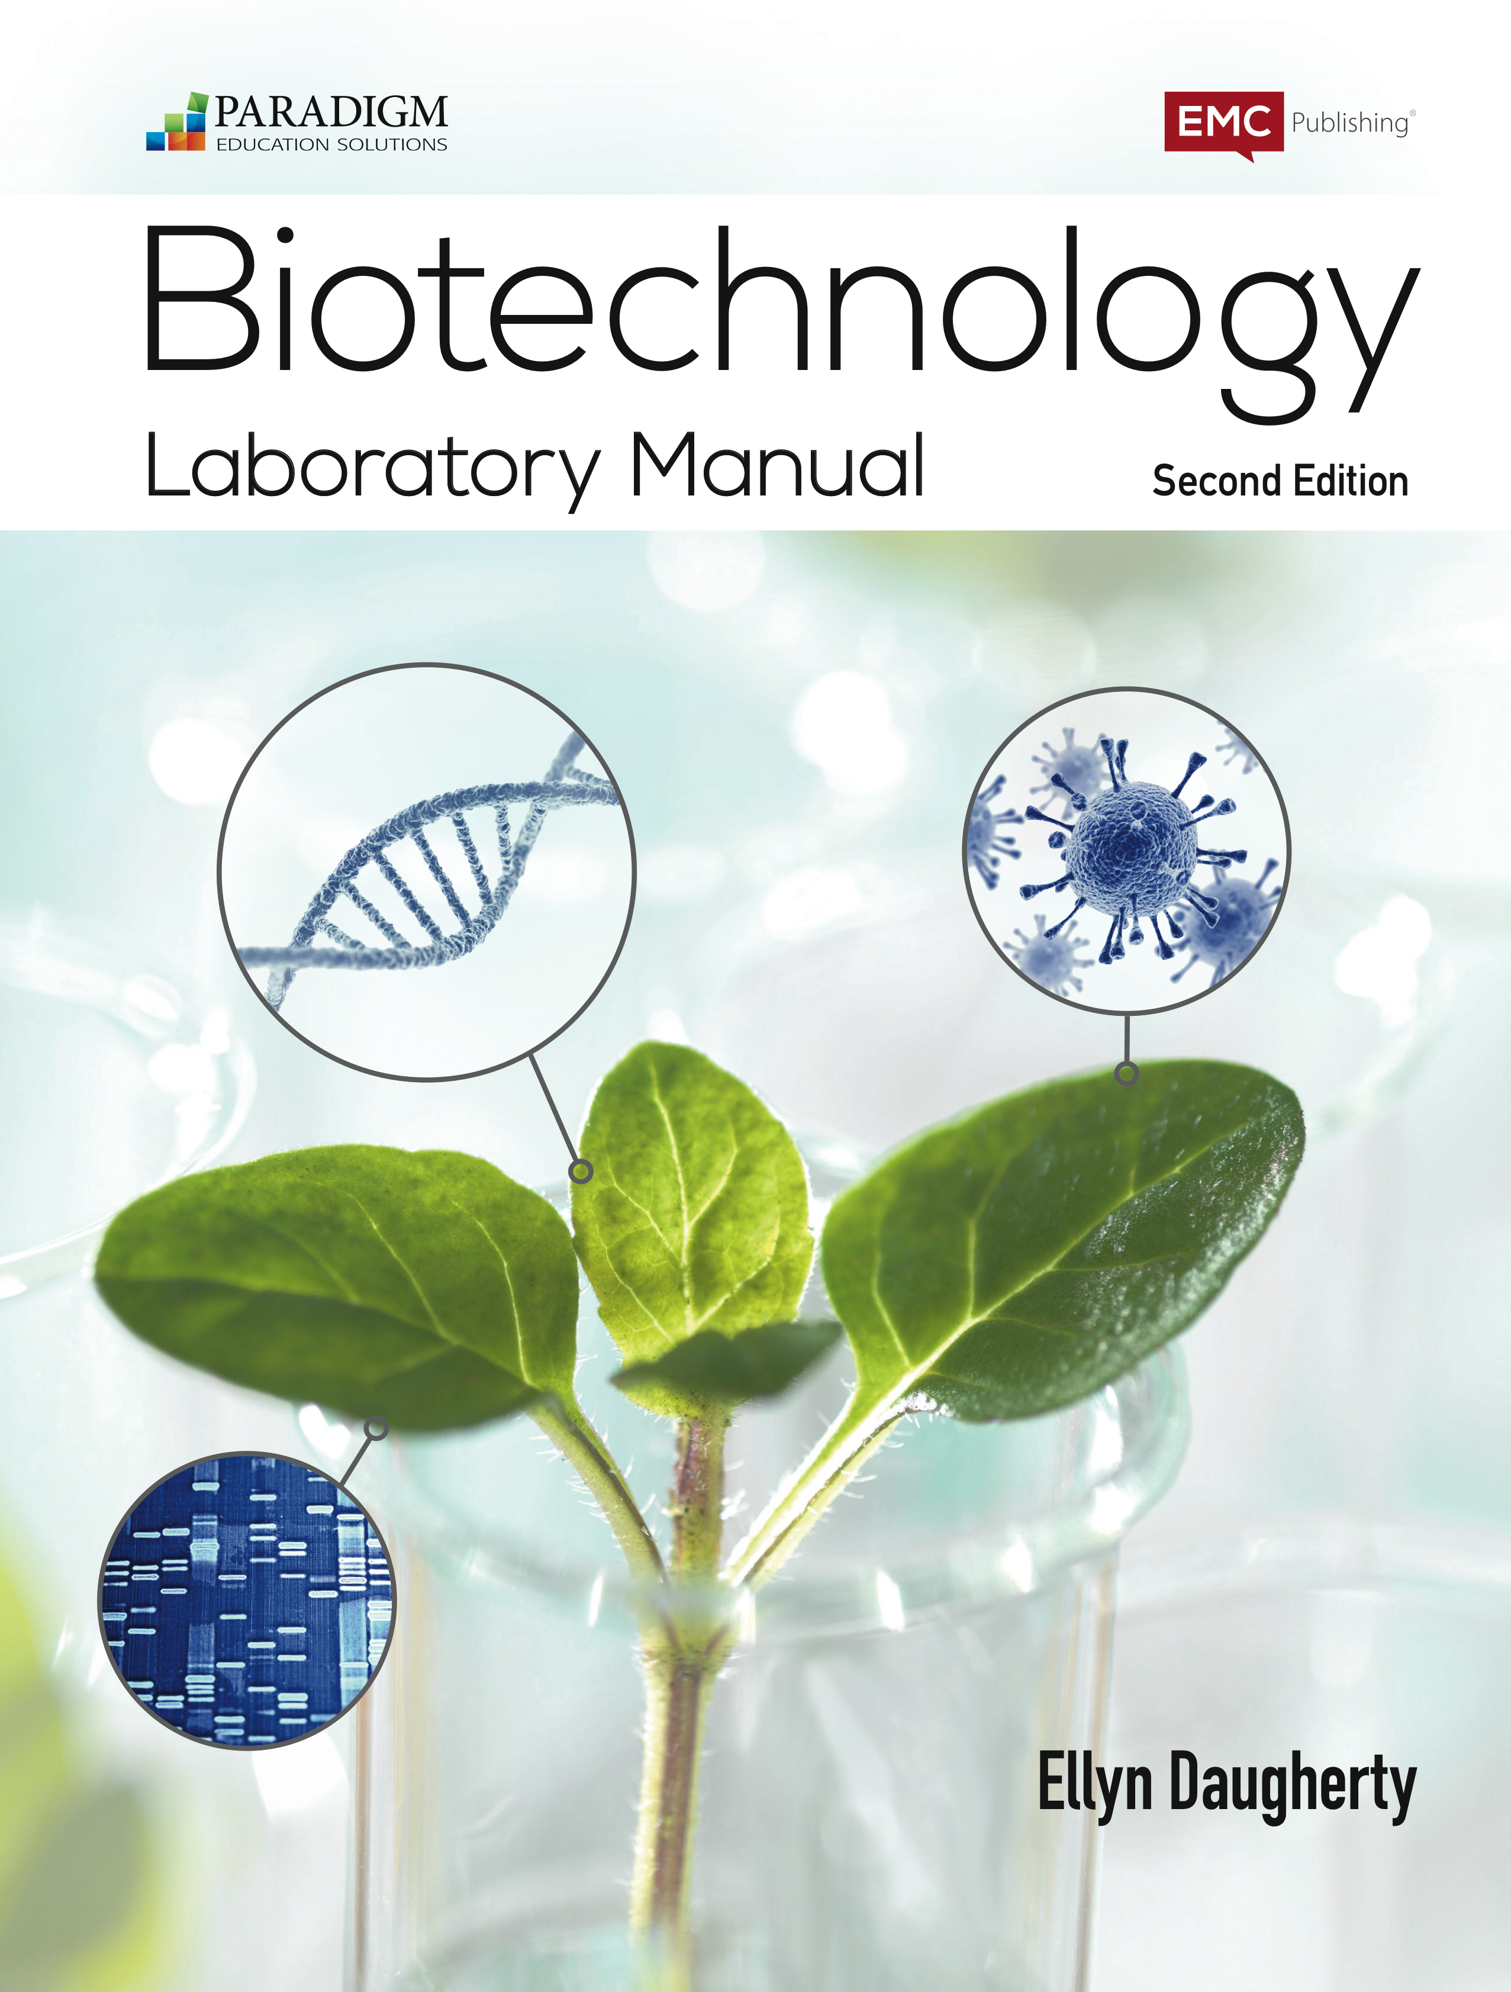
Proteins are the Cash of Biotech
B:S4NM - The rAmylase Project Kits - Kit # BTNM-5f
Lab 5F Characterizing Proteins using PAGE
Brought to you by
Fisher Science Education
G-Biosciences
and
Ellyn Daugherty
ellyn@BiotechEd.com
www.BiotechEd.com
While you wait, please:
1) Read through the lab sheets.
2) Not an expert micropipetter?
Ask someone near you to review with you.
3) Do Procedure Part I, Step 1 = Label tubes.

Slide 2
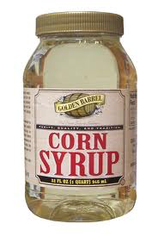
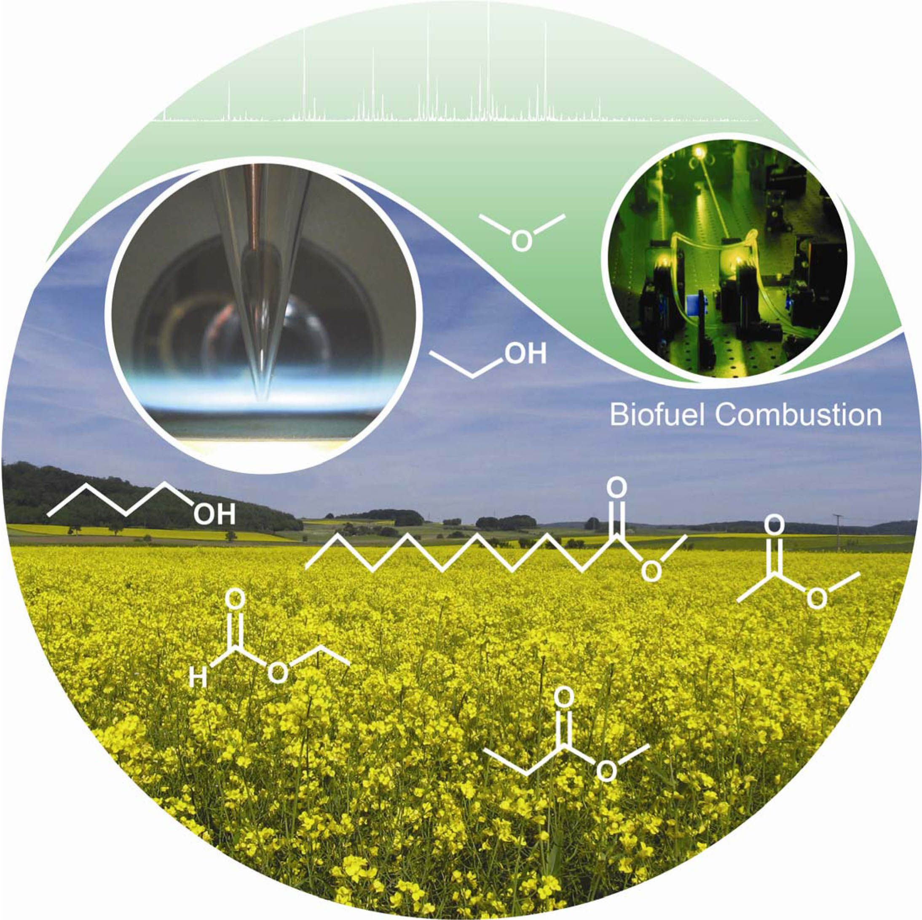
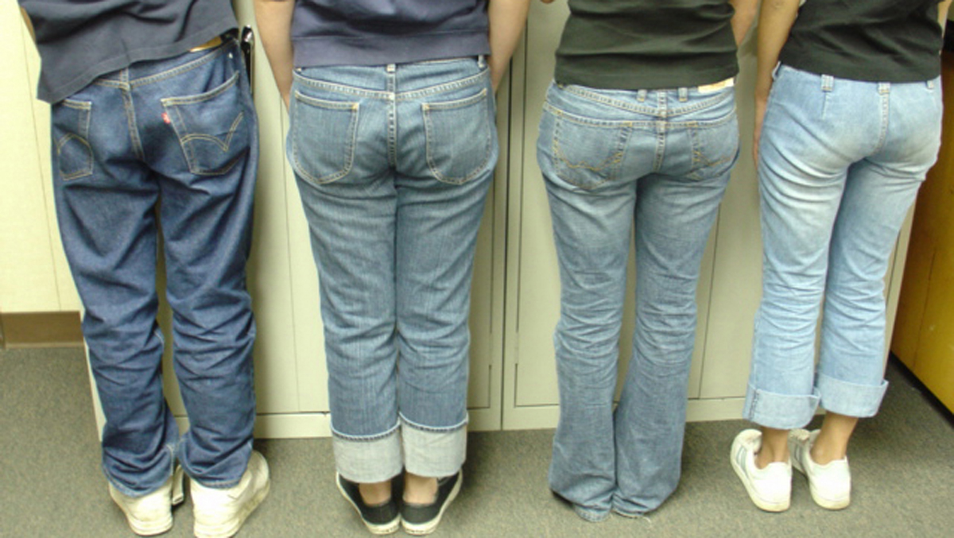
Amylase is a
commercially important biotech product
Amylase is an enzyme that catalyzes starch digestion to sugar. Used to:
Remove starch in products
Produce sugar from starch
Processing of cellulostic biofuel

Slide 3
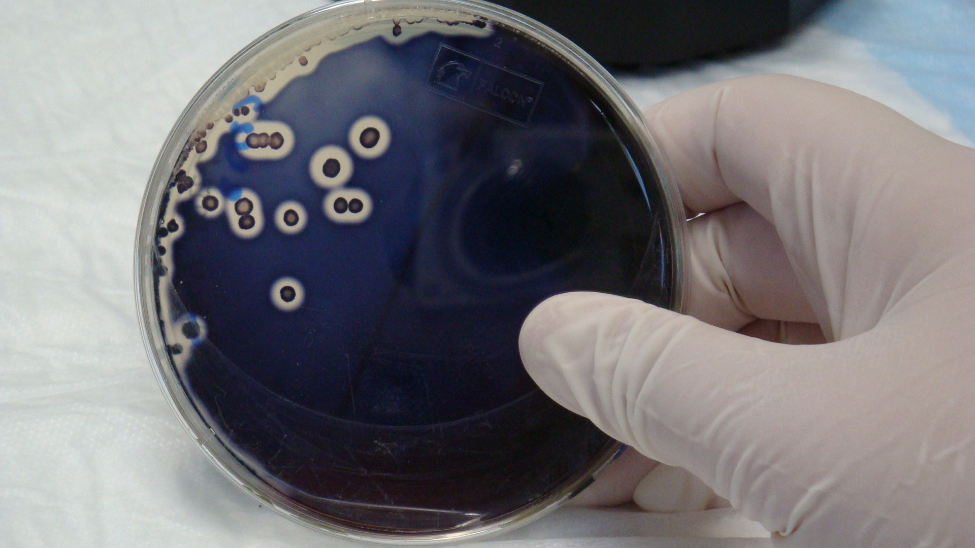
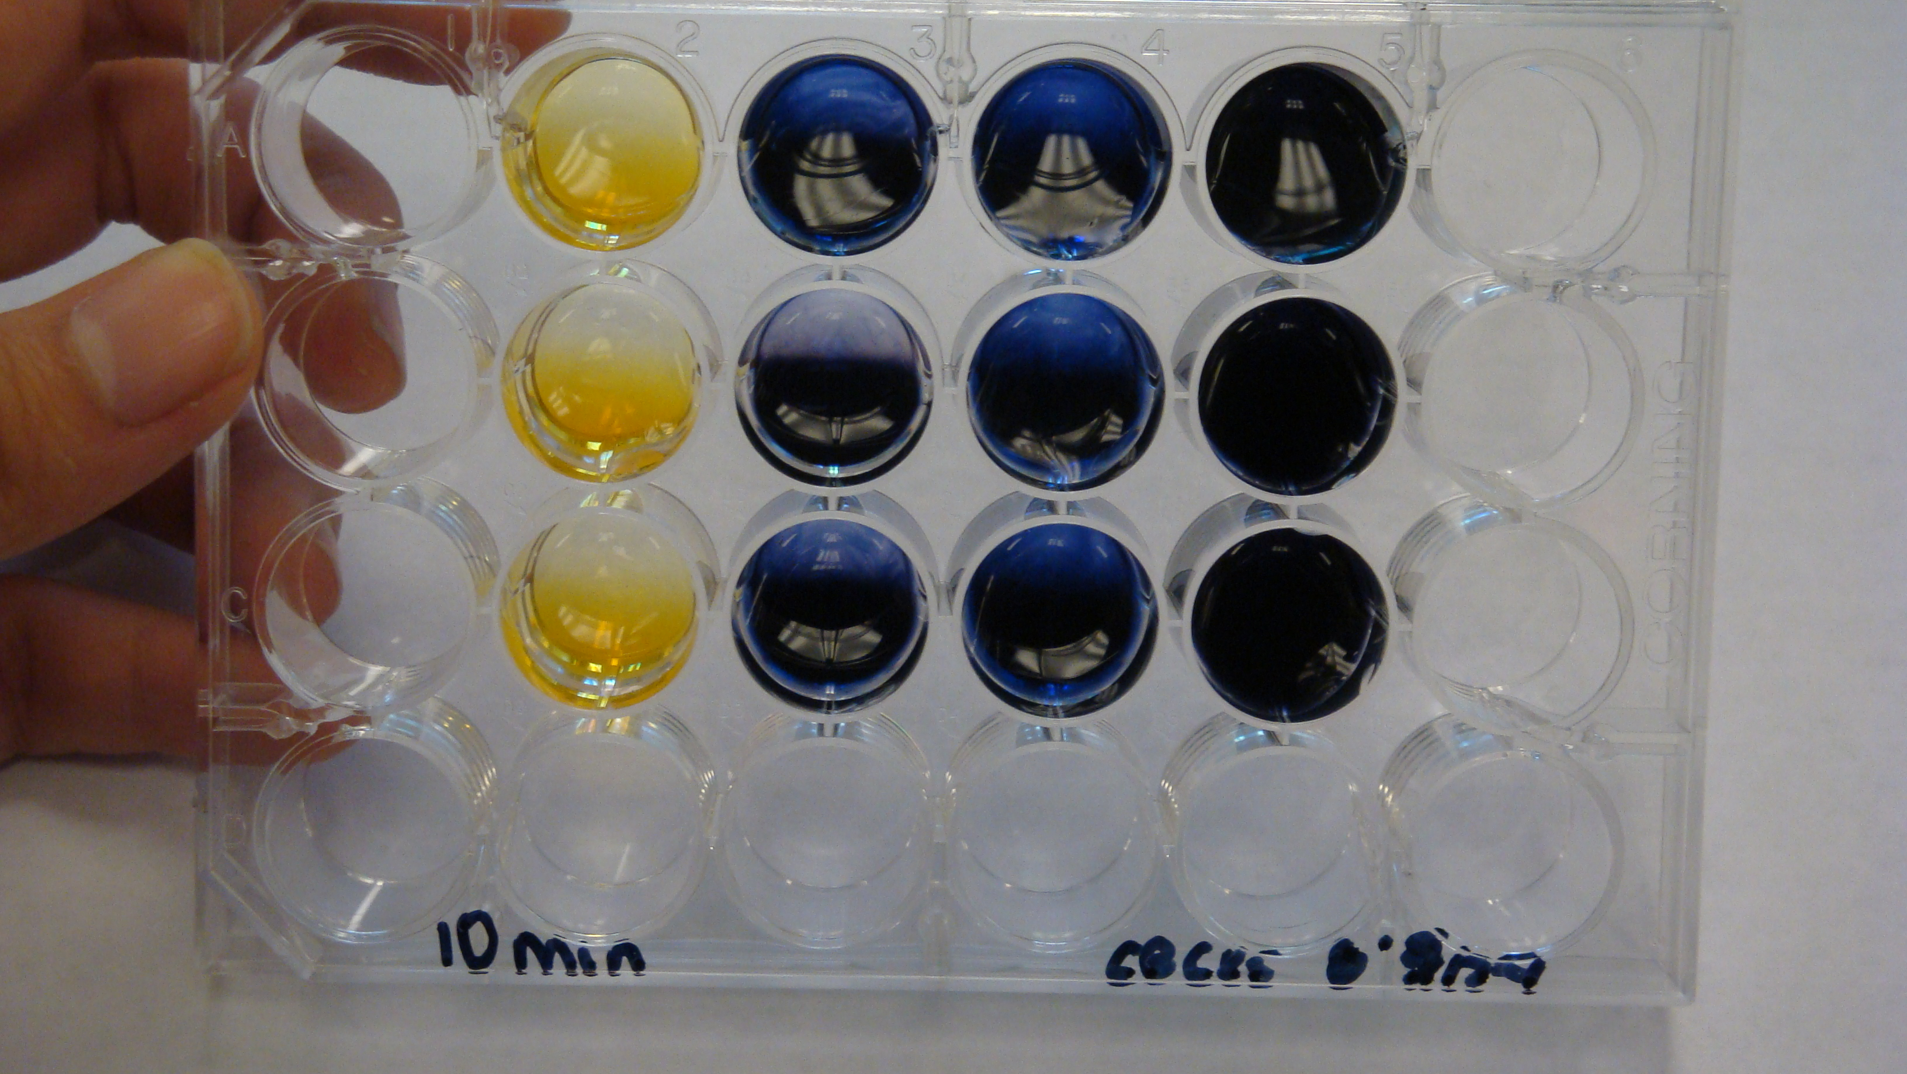
The goal of The rAmylase Project is to
Learn how to assay for amylase, a protein of commercial interest (rAmylase)
Genetically engineer cells to produce amylase (using pAmylase2014)
Grow transformed cells to volumes where amylase is purified and assayed

Slide 4
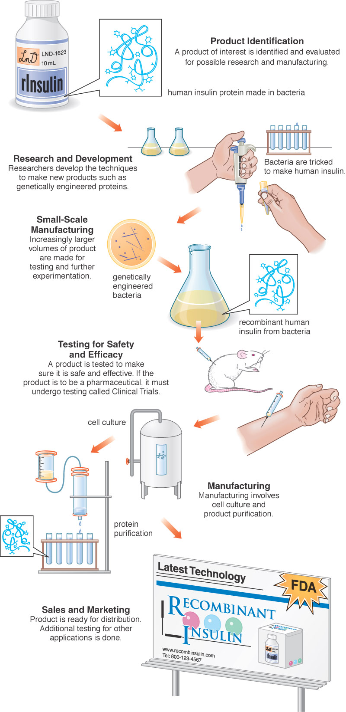
The rAmylase Project Curricular model of rDNA/protein Business
Chapters 1-5 Basic SLOP
Lab 5f Characterizing Proteins by PAGE
Lab 6c Assaying for Amylase Activity
Lab 6d Direct ELISA of Bacterial Amylase
Lab 6e Western Blot to Identify Amylase
Lab 7g Amylase Concentration Assay
Lab 8b pAmy Plasmid Restriction Digestion
Lab 8c pAmylaseTransformation of E. coli
Lab 8g Miniprep for pAmylase Isolation
Lab 9c Amylase Ion-Ex Chromatography
Lab 13h Amylase Gene PCR
BS4NM Fig 1.21

Slide 13
Computer Modeling of Bacterial Amylase
2 good options:
1a) Using Cn3D, downloadable from NCBI (Tools) … can study the different forms of bacterial amylase
1b) Go to >>> https://www.ncbi.nlm.nih.gov Pick “Structure” in Databases and type “alpha amylase Bacillus licheniformis” in search box
1c) Find entry = PDB ID: 1BLI (download structure) Then in the entry look for “Similar Structures” … and find the engineered alpha amylase = PDB ID: 1E3Z
1d) Download VAST to compare the structures
2a) Use Molecular World application for iPad or iPhone.
Use PDB ID: 1BLI and 1E3Z

Slide 14
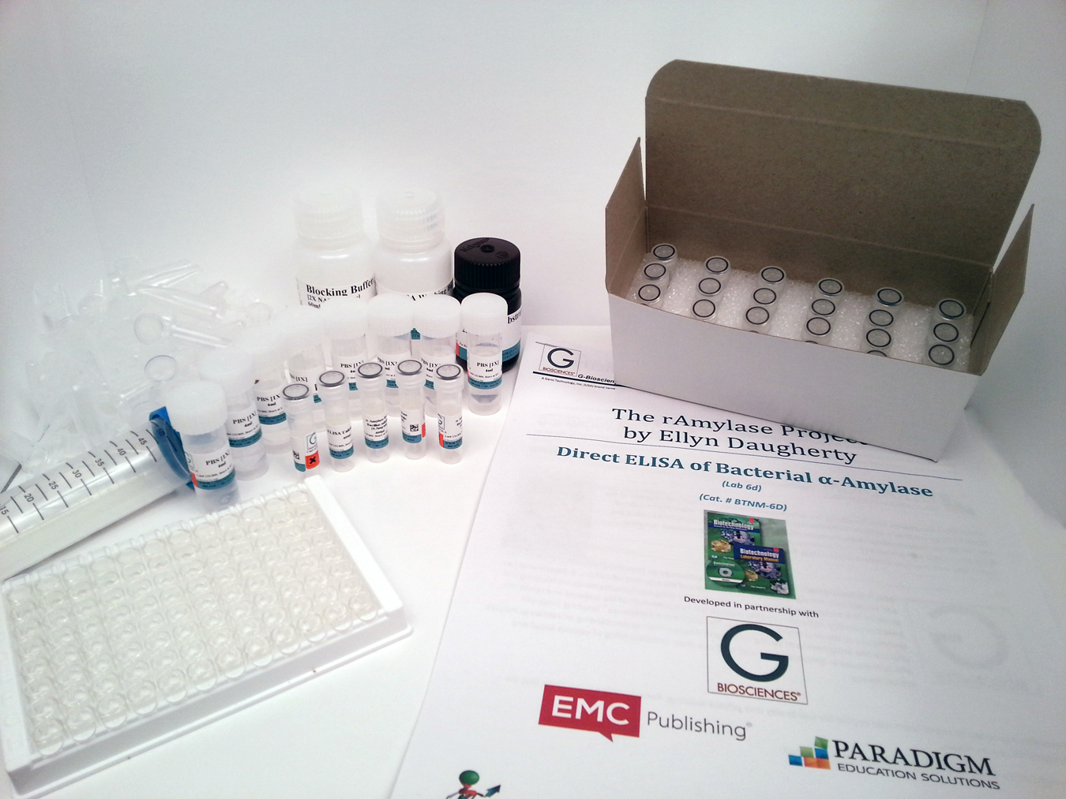
G-Biosciences’ BS4NM Laboratory Kits
Lab 5f
Characterizing Proteins Using PAGE
G-Bio’s BTNM-5f kit
BS4NM “The rAmylase Project
Models the production of a real biotech product, rAmylase.
10 G-Bio The rAmylase Project Kits
http://www.gbiosciences.com/BTSNM.aspx
Lab Kits from G-Biosciences,
available through
Fisher Science Education
give educators options for
student biotech
lab skill development.

Slide 15
BS4NM/Fisher Science Education/ G-Biosciences Education Materials Lists
Current BS4NM materials lists are available at fisheredu.com/bs4nm
FSE/GBio/BS4NMN Lab Materials Support Team:
Colin Heath, G-Biosciences, Research and Development cheath@gbiosciences.com
Lacey Cirinelli, Fisher Science Education Product Support lacey.cirinelli@thermofisher.com
Ellyn Daugherty, BS4NM Author, Educator, Consultant ellyn@BiotechEd.com

Slide 16
Biotechnology Curricular Support
www.BiotechEd.com

